Slide 1
IoT Security and Privacy
Assessing the impact on networks and the consumer
  Rajnesh Singh
  Regional Bureau Director for Asia-Pacific
    singh@isoc.org

Slide 2
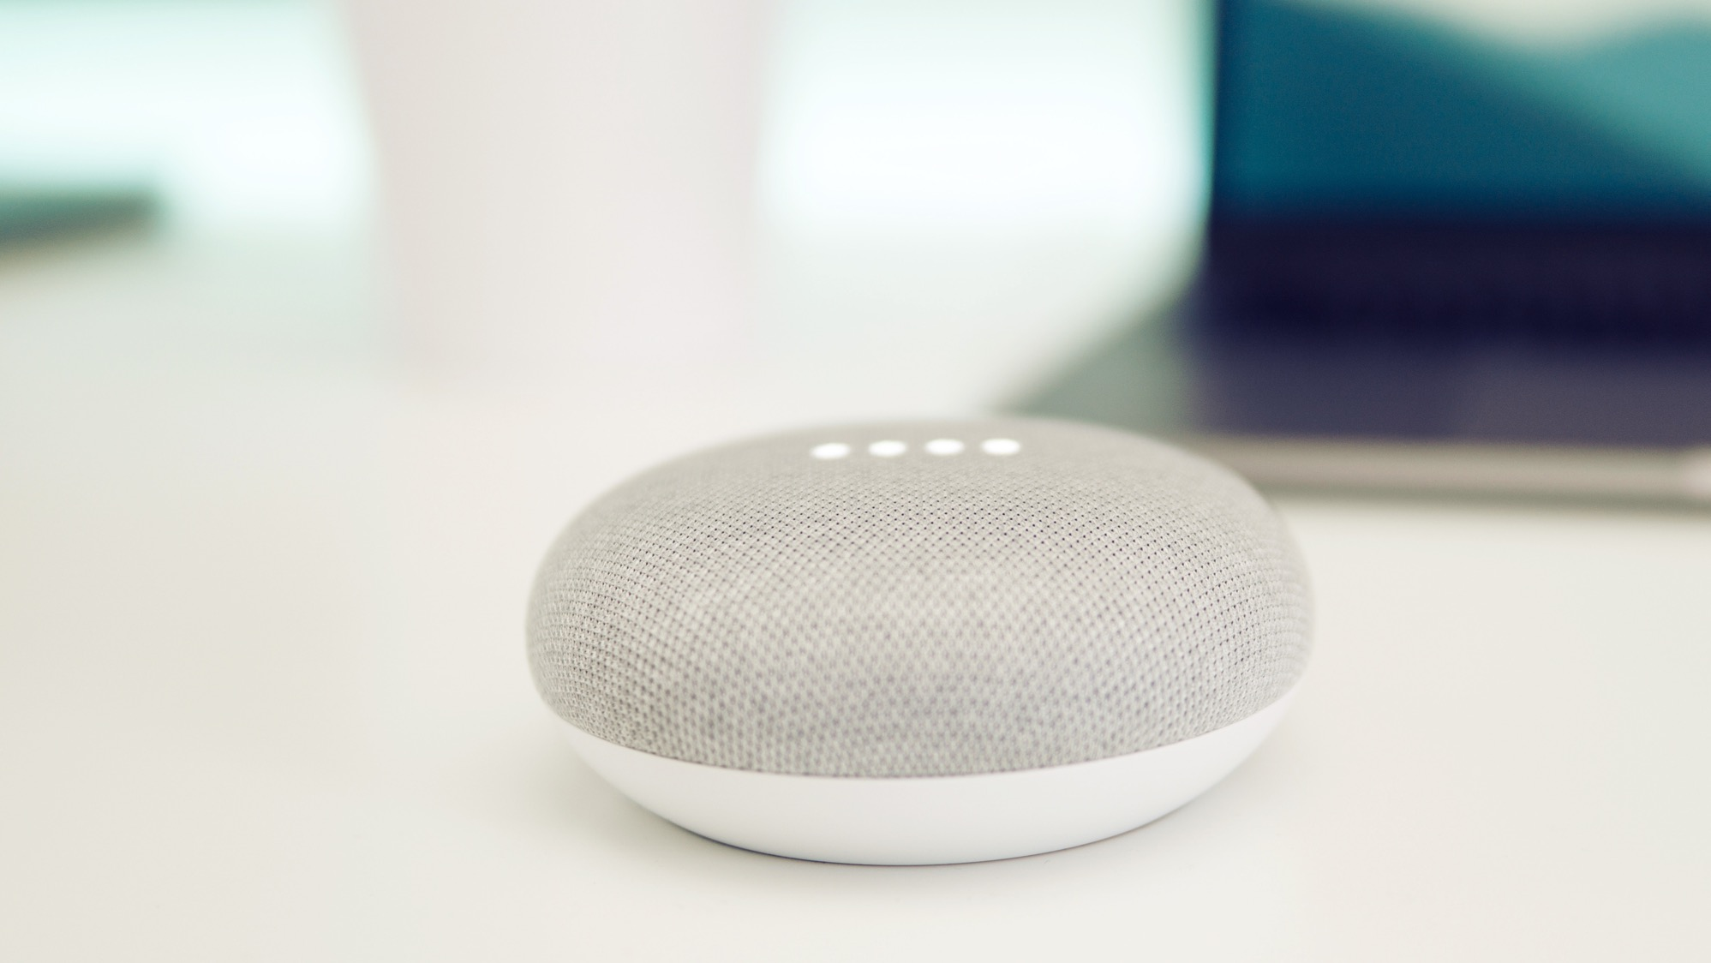
The number of IoT devices and systems
connected to the Internet will be more than
2.5x the global population
by 2020 (Gartner).

Slide 3
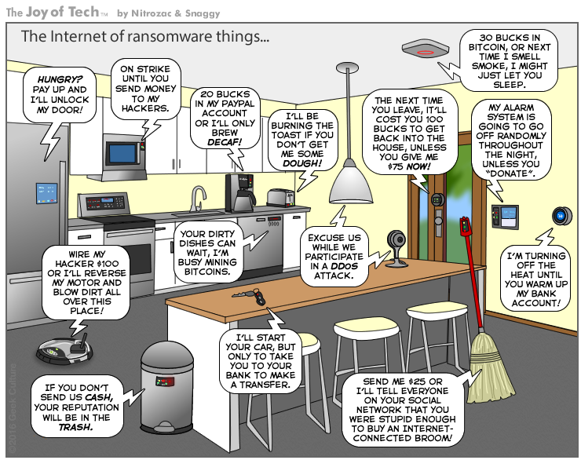
As more and more devices are connected, privacy and security risks increase.
Used with permission. http://www.geekculture.com/joyoftech/joyarchives/2340.html

Slide 4
The challenges we face

Slide 5

New devices, new vulnerabilities
The attributes of many IoT devices present new and unique security challenges compared to traditional computing systems.
Device Cost/Size/Functionality
Volume of identical devices (homogeneity)
Long service life (often extending far beyond supported lifetime)
No or limited upgradability or patching
Physical security vulnerabilities
Access
Limited user interfaces (UI)
Limited visibility into, or control over, internal workings
Embedded devices
Unintended uses
BYOIoT
Notes:
Industry is not adequately addressing fundamental security, privacy and life-safety issues.
Many manufacturers are new to the networking and Internet arena, and lack experience.
There are STRONG competitive pressures for speed to market and cost reduction.
Security and privacy cost money, require specialized skills, and slow down the development process.
The proliferation of devices, and corresponding interactions with other devices, increase the “surface” available for cyberattack.
Poorly secured devices affect the security of the Internet and other devices globally, not just locally.

Slide 6
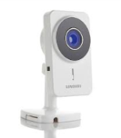

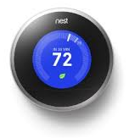
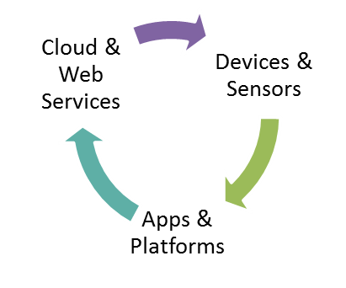
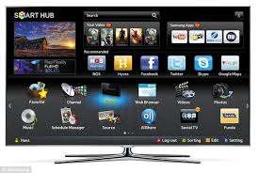

Key Challenge: IoT Ecosystem
Three Dimensions:
Combination of devices, apps, platforms & services
Data flows, touch points
& disclosures
Lack of defined standards
Impacts on Sustainability Issues:
Lifecycle supportability
Data retention / ownership

Slide 7
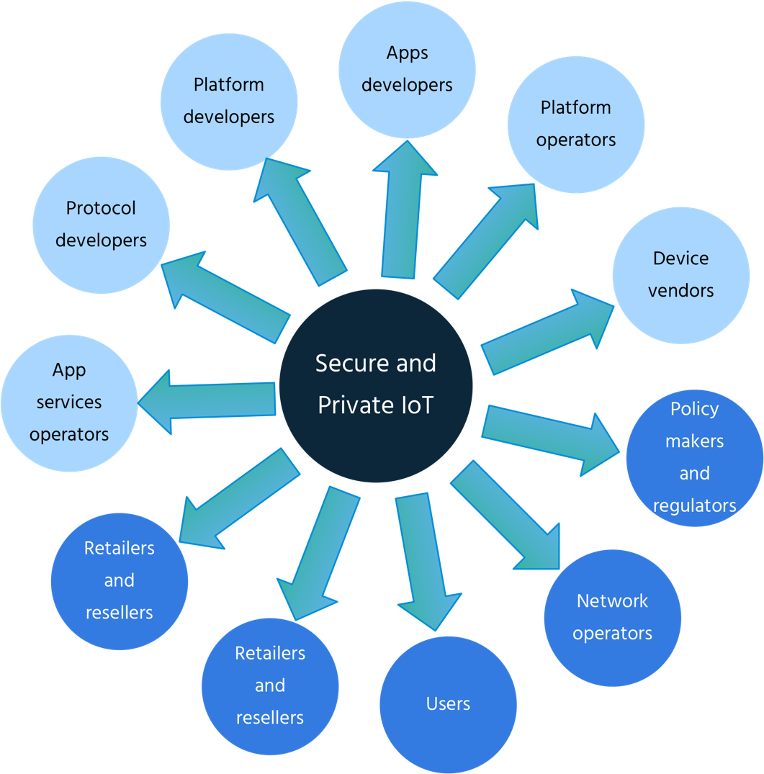
Who is responsible?
  Developers and users of IoT devices and systems have a collective obligation to ensure they do not expose others and the Internet itself to potential harm
  To scale up we need a collective approach, addressing security challenges on all fronts.

Slide 8
What we’re doing about it

Slide 9
There are two ways to view IoT Security
Inward Security
  Focus on potential harms to the health, safety, and privacy of device users and their property stemming from compromised IoT devices and systems
Outward Security
  Focus on potential harms that compromised devices and systems can inflict on the Internet and other users
Notes:
Example of outward risk:
A home appliance may continue to function well as far as the direct user is concerned, and s/he may be unaware that it is part of a botnet participating in a DDoS attack
Toaster example:
- Someone may use it against you, and remotely decide to burn your hands our even your house (inward security related issue)
Your toaster works ok but is being used for a major DDOS attack (outward)
At ISOC, our focus is on the impact that IoT security and privacy has on the Internet and other users.

Slide 10
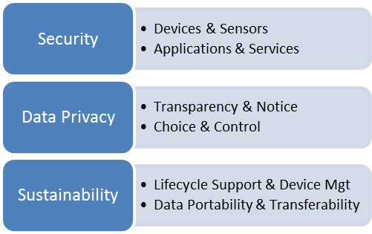
Online Trust Alliance IoT Security & Privacy Trust Framework
    Measureable principles vs. standards development
    Consumer grade devices (home, office and wearables)
    Address known vulnerabilities and IoT threats
    Actionable and vendor neutral
https://otalliance.org/iot/
Notes:
June 2015 kick off, consensus driven process with input from industry and policy-makers
Multi-stakeholder working group – 100 plus participants
Face-To-Face meetings / Public Call for Comments
Ongoing refinement
Working Group Focus

Slide 11

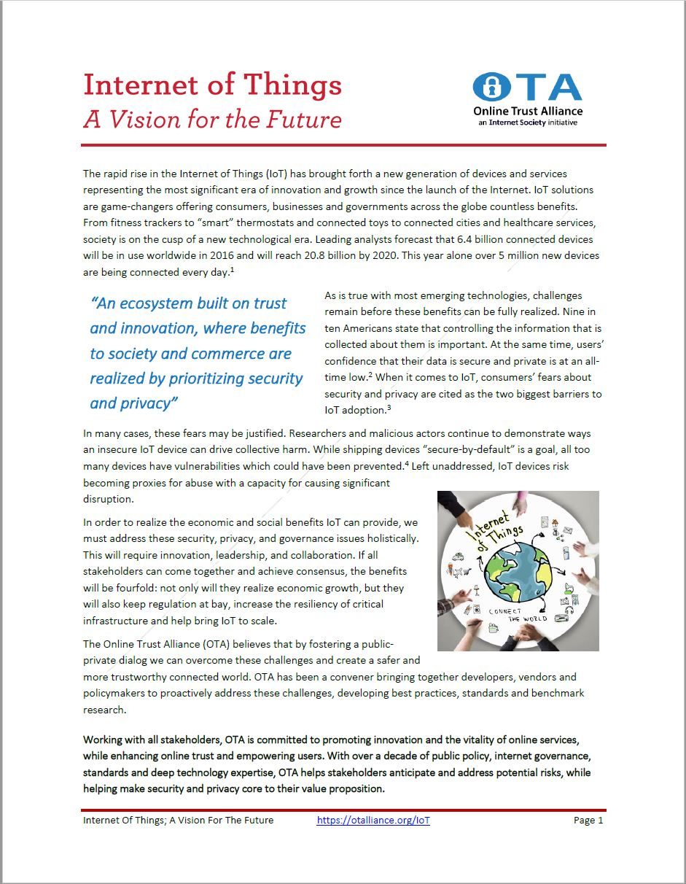
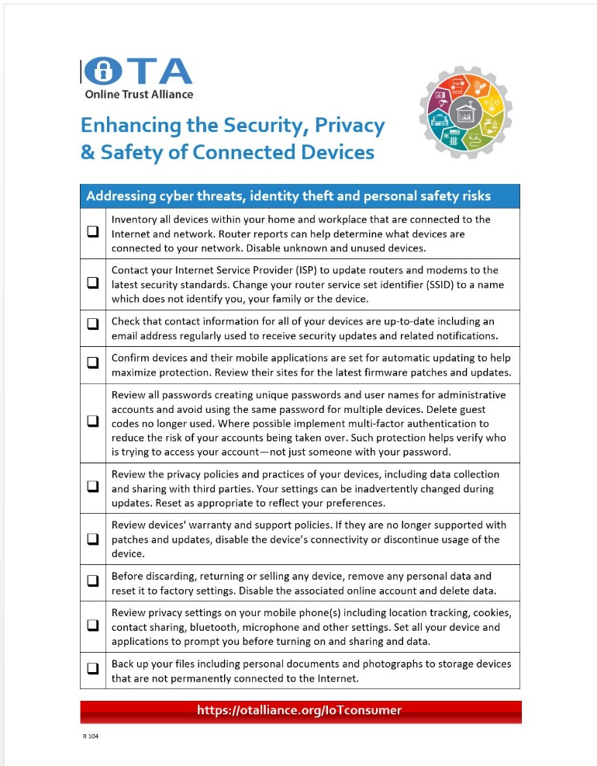
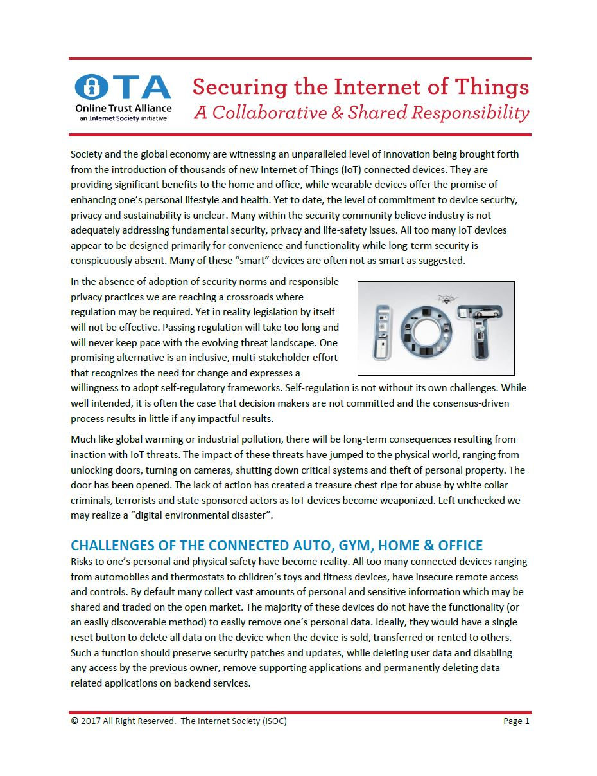
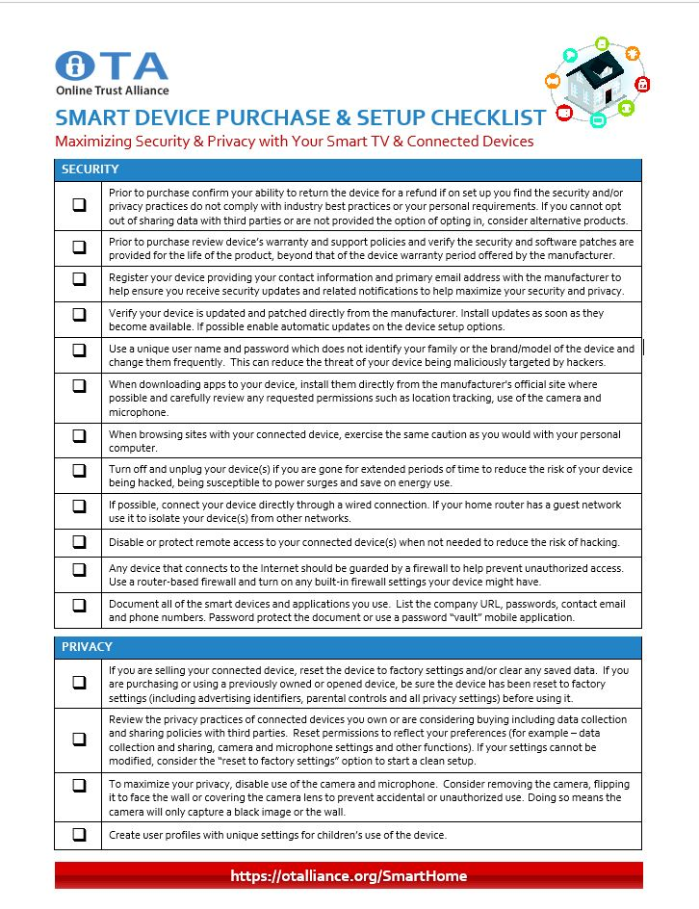
Online Trust Alliance IoT Security Resources
Notes:
The Framework is broken down into 4 key areas:
Security Principles (1-12) – Applicable to any device or sensor and all applications and back-end cloud services. These range from the application of a rigorous software development security process to adhering to data security principles for data stored and transmitted by the device, to supply chain management, penetration testing and vulnerability reporting programs. Further principles outline the requirement for life-cycle security patching.
User Access & Credentials (13-17) – Requirement of encryption of all passwords and user names, shipment of devices with unique passwords, implementation of generally accepted password reset processes and integration of mechanisms to help prevent “brute force” login attempts.
Privacy, Disclosures & Transparency (18-33) – Requirements consistent with generally accepted privacy principles, including prominent disclosures on packaging, point of sale and/or posted online, capability for users to have the ability to reset devices to factory settings, and compliance with applicable regulatory requirements including the EU GDPR and children’s privacy regulations. Also addresses disclosures on the impact to product features or functionality if connectivity is disabled.
Notifications & Related Best Practices (34-40) - Key to maintaining device security is having mechanisms and processes to promptly notify a user of threats and action(s) required. Principles include requiring email authentication for security notifications and that messages must be communicated clearly for users of all reading levels. In addition, tamper-proof packaging and accessibility requirements are highlighted.

Slide 12
ISOC “IoT Trust by Design” Campaign
1
  Work with manufacturers and suppliers to adopt and implement the OTA IoT Trust Framework
2
  Mobilize consumers to drive demand for security and privacy capabilities as a market differentiator
3
  Encourage policy and regulations to push for better security and privacy features in IoT
Notes:
Consumers
We want to raise awareness of the privacy and security risks and encourage consumers to voice their concerns
Policymakers and Regulators
We want policymakers to create a policy environment that favors strong security and privacy features in IoT products and services

Slide 13
Activity highlights
OTA IoT Trust Framework implementation
Best practices and toolkits
Implementation guide
Training for ISOC and community
Global, regional and local partnerships
Security-minded IoT alliances
Certification organizations
Civil society organizations
Organizations that review consumer products
Internet Society community
Research
Paper on IoT Security for Policymakers
Policy research: mapping the IoT policy/regulatory landscape
Economic study on IoT security externalities
Study on “consumer grade” IoT markets, to better understand manufacturing trends and consumer behaviour
Outreach to policy makers
Regional engagement in strategic countries
Global and regional events
Workshops and capacity building
Thought pieces and articles

Slide 14
Thoughts and suggestions?

